Slide 1

Major-II
School of Computer Science
University of Petroleum & Energy Studies, Dehradun
Project Title
Conversion Of Hand Written Text into Text Using Computer Vision
Created by:-
Mentor:-
Dr. Hitesh Kumar Sharma
Assistant Professor-SS,
School of Computer Science
Adesh Kumar Gupta
Shankey Gupta
Tushar Singh
Utkarsh Sandeep Singh

Slide 2
CONTENTS
ABSTRACT
INTRODUCTION
PROBLEM STATEMENT
OBJECTIVE
METHODOLOGY
PERT CHART
USE CASE
FLOW CHART
ALGORITHM
PROGRESS
REFRENCES

Slide 3
Abstract
 This tool is useful for recognizing all alphabets (English) given as in input image. Once input image of character is given to proposed system, then it will recognize input character which is given in image. Recognition and classification of characters are done by Neural Network. The main aim of this project is to effectively recognize a particular character of type format using the Artificial Neural Network approach.

Slide 4
Introduction
The system will be developed in the python language which is the go-to language when it comes to ML/DL application as it provides ample number of libraries to develop an end to end tool which takes grayscale image of a letter as input according to its pixel values and converts it into computer text.
We have also measured and compared the accuracy of different machine learning classification algorithm.

Slide 5
Problem Statement
 Existing hand writing recognition systems use complex architecture which are not beginner friendly and are modified in a way such that they can be used with only their specific software therefore this project was to develop an easy to understand hand writing recognition system which is easy to use and understand and is compatible in all environment.

Slide 6
Objective
Main Objectives
Here we are delivering an end-to-end tool which will used to identify the characters of text given by end-user and help him/her convert it into text.
Sub Objectives
To construct suitable neural network and train it properly to recognize characters.
Reduce man-power to convert text into digitized form manually.

Slide 7
Methodology
Machine Learning Techniques like Logistic Regression, SVM, Decision Tree, Random Forest and CNN are very powerful classification techniques when it comes to finding a trend between the variables and classify them under a category. Generally, all Machine Learning techniques follow a similar procedure-
Get Data for different Sources etc.
Extract Important Features to work on.
Choose a Machine Learning Model.
Train the model, improve it and test it.
Lastly, Deploy and Service the end user.

Slide 8
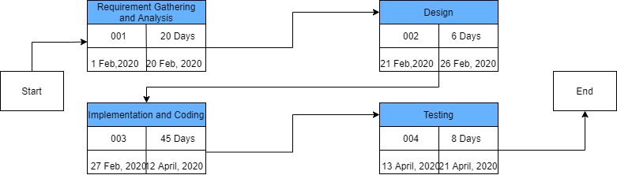
Pert Chart

Slide 9
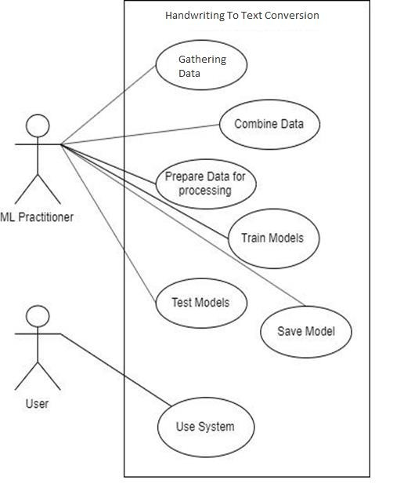
Use Case

Slide 10
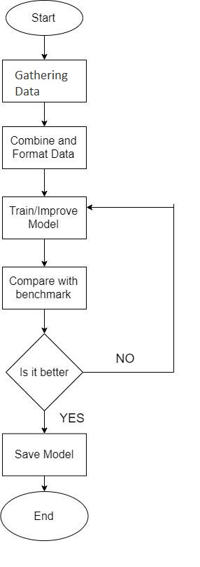
Flow Chart

Slide 11
Algorithms
Logistic Regression
dataset <- read.csv
X <- array of dependent v ariable
y <- array of independent v ariable
Splitting Datsdet
X_t rain <- matrix of independent training values
X_t est <- matrix of independent testing values
y_t rain <- array of dependent training values
y_t est <- array of dependent testing values
Feature scaling
sc <- St andardScaler()
fit _t ransform X_t rain
transform X_t est
Fitting model to training set
classifier <- LogisticRegression()where random state = 0
fit model
Predict result
y_pred <- array of predict ed values
accuracy <- calculated accuracy of the model from test values and predict ed values
cm <- confusion matrix of test values and predict ed values

Slide 12
 Support Vector Machine
dataset <- read.csv
X <- array of dependent variable
y <- array of independent variable
Splitting Datsdet
X_train <- matrix of independent training values
X_test <- matrix of independent testing values
y_train <- array of dependent training values
y_test <- array of dependent testing values
Feature scaling
sc <- StandardScaler()
fit_transform X_train
transform X_test
Fitting model to training set
classifier <- SVC() where kernel = linear, random state = 0
fit model
Predict result
y_pred <- array of predicted values
accuracy <- calculated accuracy of the model from test values and predicted values
 cm <- confusion matrix of test values and predicted values

Slide 13
 Decision Tree
dataset <- read.csv
X <- array of dependent variable
y <- array of independent variable
Splitting Datsdet
X_train <- matrix of independent training values
X_test <- matrix of independent testing values
y_train <- array of dependent training values
y_test <- array of dependent testing values
Feature scaling
sc <- StandardScaler()
fit_transform X_train
transform X_test
Fitting model to training set
classifier <- DecisionTreeClassifier() where criterion = entropy, random state = 0
fit model
Predict result
y_pred <- array of predicted values
accuracy <- calculated accuracy of the model from test values and predicted values
cm <- confusion matrix of test values and predicted values

Slide 14
 Random Forest
dataset <- read.csv
X <- array of dependent variable
y <- array of independent variable
Splitting Datsdet
X_train <- matrix of independent training values
X_test <- matrix of independent testing values
y_train <- array of dependent training values
y_test <- array of dependent testing values
Feature scaling
sc <- StandardScaler()
fit_transform X_train
transform X_test
Fitting model to training set
classifier <- RandonForestClassifier() where estimators = 10, criterion = entropy, random_state = 0
fit model
Predict result
y_pred <- array of predicted values
accuracy <- calculated accuracy of the model from test values and predicted values
cm <- confusion matrix of test values and predicted values

Slide 15
 CNN
define get_image_define size() to get the image shape and size
define get_num_of_classes() to store the number of gestures
define cnn_model()
get the number of classes
model.add(conv2d(input layer, filters, kernel size, activation function, name))
model.add (maxpooling2D(poolsize ,strides))
model.add (conv2d( filters, kernel size, activation function))
model.add (maxpooling2D(poolsize ,strides))
model.add (flatten())
model.add(Dense(128, activation_function=relu))
model.add(Dropout_function())
model.add(Dense(num_of_classes, activation='softmax'))
model.compile(loss='categorical_crossentropy', optimizer, metrics=accuracy)
callbacks_list ( [ModelCheckpoint(filepath, monitor='val_acc', verbose=1, save_best_only=True, mode='max')])
plot model
return model, callbacks_list

Slide 16
 define train
train_imagesßarray(pickle.load(train_images))
train_labelsßarray(pickle.load(train_labels))
test_imagesßarray(pickle.load(test_images)) 4.4test_labelsßarray(pickle.load(test_labels))
model, callbacks_list = cnn_model()
model.fit(train_images, train_labels, validation_data=(val_images, val_labels),
epochs=10, batch_size=500, callbacks=callbacks_list)
scores = model.evaluate(val_images, val_labels, verbose=0)
print(CNN Error)
 call train()

Slide 17
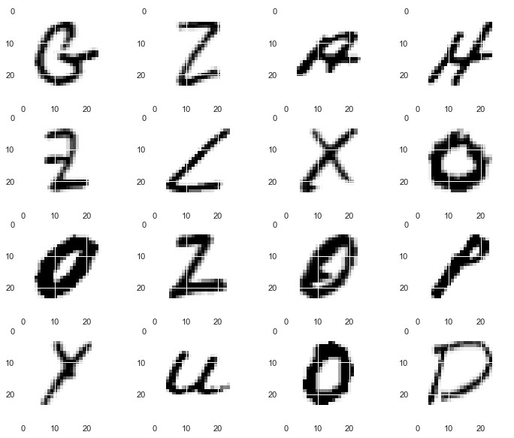
Progress
Data Image

Slide 18
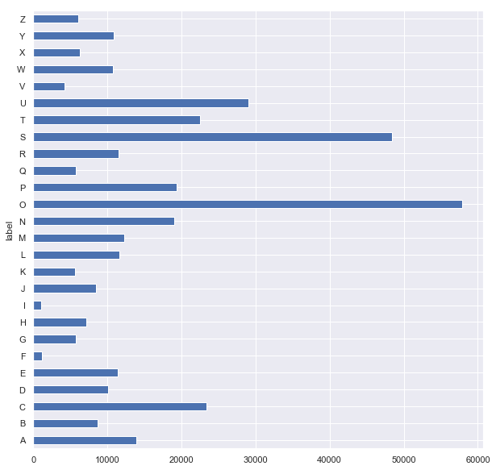
Frequency of Data

Slide 19
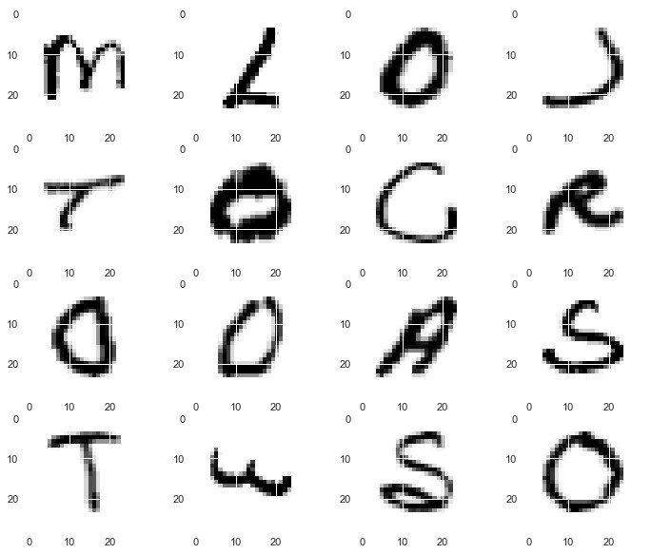
Data Scaling

Slide 20
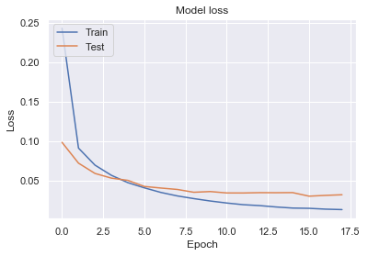
Model Loss

Slide 21
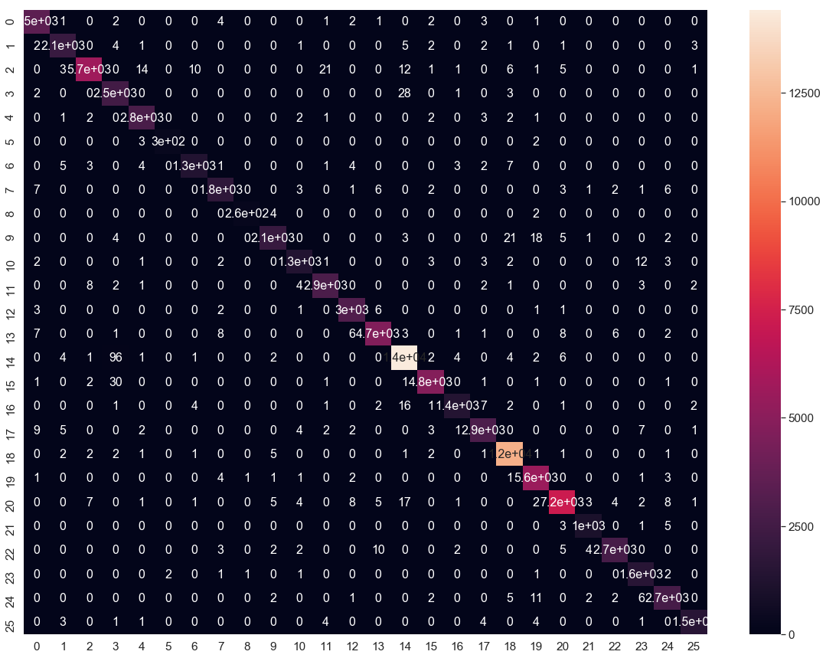
Confusion Matrix

Slide 22
References
Isha Vats, Shamandeep Singh, “Offline Handwritten English Numerals Recognition using Correlation Method”, International Journal of Engineering Research and Technology (IJERT): ISSN: 2278-0181 Vol. 3 Issue 6, June 2014. Access Date: 09/07/2015.
Gunjan Singh,Sushma Lehri, “ Recognition of Handwritten Hindi Characters using Back
propagation Neural Network”, International Journal of Computer Science and Information Technologies ISSN 0975-9646, Vol. 3 (4) , 2012,4892-4895. Access Date:09/07/2015.
S S Sayyad, Abhay Jadhav, Manoj Jadhav, Smita Miraje, Pradip Bele, Avinash Pandhare, ‘Devnagiri Character Recognition Using Neural Networks” ,International Journal of Engineering and Innovative Technology (IJEIT)Volume 3, Issue 1, July 2013. Access Date: 09/07/2015.
Shabana Mehfuz,Gauri katiyar, ‘Intelligent Systems for Off-Line Handwritten Character Recognition: A Review” ,International Journal of Emerging Technology and Advanced Engineering Volume 2, Issue 4, April 2012. Access Date: 09/07/2015.
Prof. Swapna Borde, Ms. Ekta Shah, Ms. Priti Rawat, Ms. Vinaya Patil, “Fuzzy Based
Handwritten Character Recognition System” ,International Journal of Engineering Research and Applications (IJERA) ISSN: 2248-9622,VNCET 30 Mar’12. Access Date: 09/07/2015.

Slide 23
THANKYOU

